Slide 1
GEOG0113: Geography in the field
Introduction to GIS & MAPPING
How to log into arcgis online
Dr Anwar Musah (a.musah@ucl.ac.uk)
Lecturer in Social and Geographic Data Science
UCL Geography
1

Slide 2
GEOG0113: Geography in the field
Introduction to GIS & MAPPING
GETTING YOU STARTED with the learning materials
Dr Anwar Musah (a.musah@ucl.ac.uk)
Lecturer in Social and Geographic Data Science
UCL Geography
2

Slide 3

What is ArcGIS Online [1]
ArcGIS online is a cloud-based GIS mapping software hosted on the internet. Can you use it just like any other GIS software package that is locally stored on the computer to create interactive maps, analyse data, create story maps as well as to share outputs with other collaborations/team members.
3

Slide 4
What is ArcGIS Online [2]
ArcGIS Map
ArcGIS StoryMap
4

Slide 5
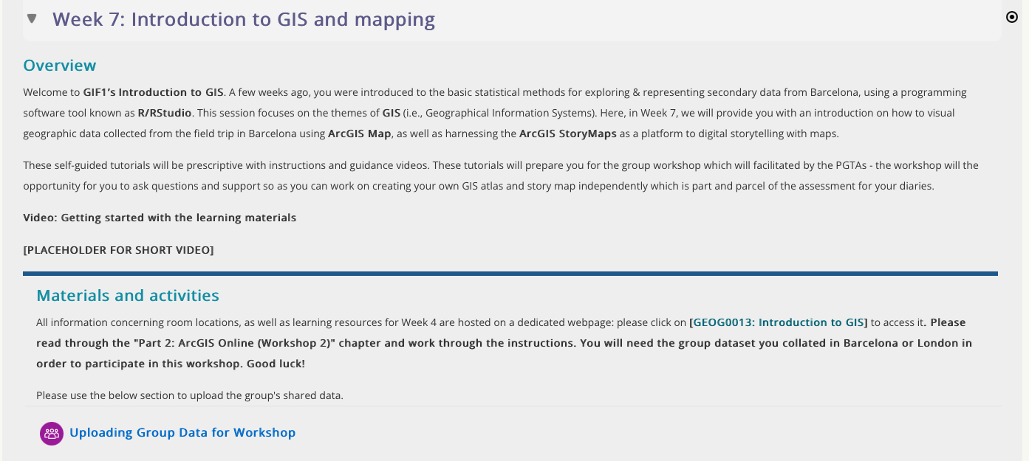
How to access the learning materials?
Please click on the link “[GEOG0013: Introduction to GIS]”
5

Slide 6
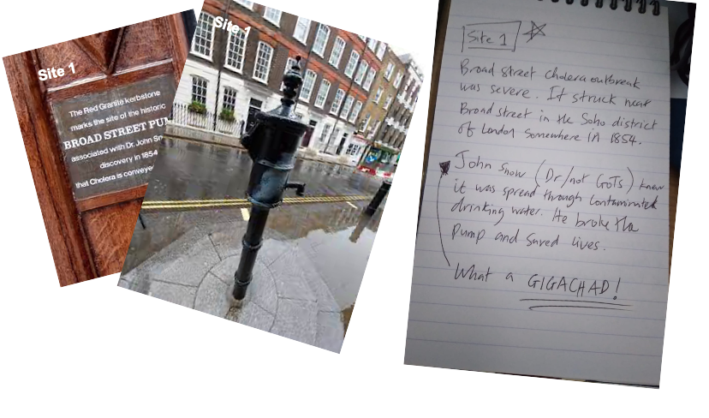

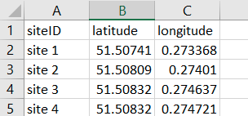
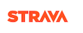
How to share you data with you colleagues [1]
Your Collected Data
Store everything into a compressed folder (< 160MB)
Pictures, videos, notes etc.,
Point data (as .csv format)
Name zip folder as “Group #”
Route data (as .gpx format)
6

Slide 7
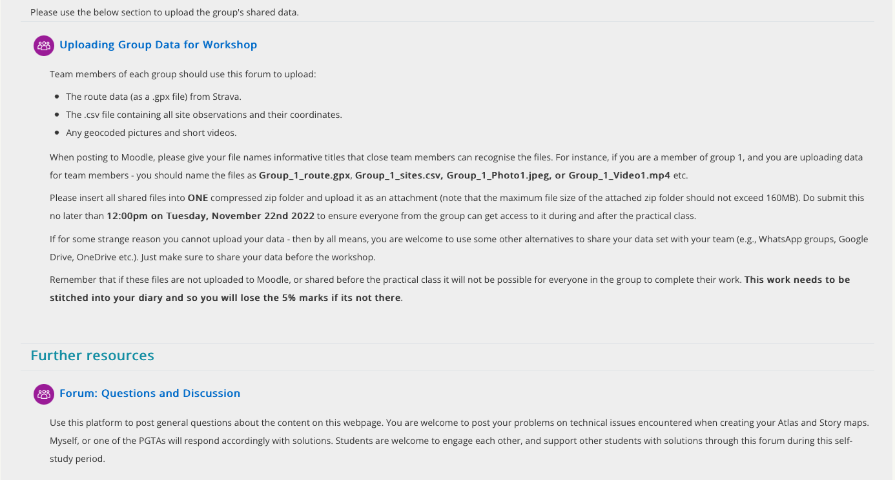
How to share you data with you colleagues [2]
Use this section in MOODLE to post you shared data for team member accordingly. Store everything into a compressed zip folder and attach it, and then post it on the forum. Use the appropriate title for team member whose data belongs to who.
7

Slide 8
How to post questions and key contacts
Contact us for critical problem only
Dr. Anwar Musah: a.musah@ucl.ac.uk
Professor Helen Bennion: h.bennion@ucl.ac.uk
Geography Office: geog.office@ucl.ac.uk
Use this section in MOODLE to post question related to ArcGIS issues or other technical problems. Myself, or one of the PGTAs will try to responds as soon as possible!
8

Slide 9
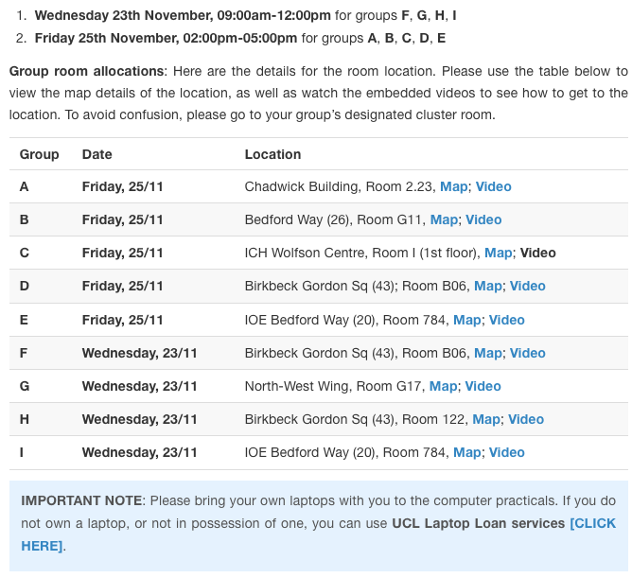
Week 7’s 3-hour Practical Workshop session
Try to complete as much of the self-guide tutorials on your own before heading into the Workshop.
The goal is to learn ArcGIS Online to prepare you for creating your own output which needs to be submitted for your diary.
You can use the workshop time to ask PGTAs to rectify any problems you encountered. They may, or may stand in front of blackboard and teach. It’s your responsibility to come in prepared.
Everyone should bring your own laptops for Wednesday and Friday.
9

Slide 10
Any questions?
a.musah@ucl.ac.uk
10

